Slide 1
Dev Community
Sign In/ Register
Main Page
Search
Create Community
Generate UML
Java
jQuery
PHP
Javascript
CSS
Html
C#
MySQL
C

Slide 2
Dev Community
Sign In or Register
Page
Search
Sign In
Register
Email
Email
Password
Password
Log In
User Name
Log In

Slide 3
Dev Community
Azargul Nazari
After Loging In
Search
Create Community
Generate UML
Java
jQuery
PHP
Javascript
CSS
Html
C#
MySQL
C

Slide 4
Dev Community
Azargul Nazari
Seeing the community profile
Search
Name
Github link
Total Particiants
About

Slide 5
Dev Community
Azargul Nazari
Creating Community
Search
Name
Github link
About
Create

Slide 6
Dev Community
Azargul Nazari
Chat room
Search
Send Message

Slide 7
Dev Community
Log Out
User Profile Page
Search
Info about user

Slide 8
Dev Community
Azargul Nazari
Generating UML
Step 1
This page shows all the availalable languages which the the UML generation supports
For this project it’s only PHP
Search
PHP

Slide 9
Dev Community
Azargul Nazari
Generating UML
Step 2
After choosing the specific language for generating UML
Here goes the uploading process of source code
Search
Upload The Source Code

Slide 10
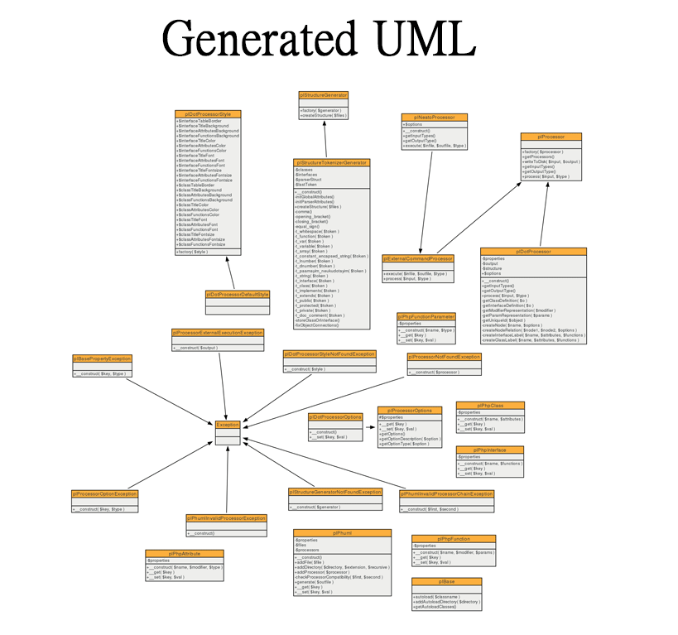
Dev Community
Azargul Nazari
Generating UML
Step 3
Here is the generated UML diagram after processing on server it will be sent back to the user
Search

